Slide 1
Traffictelligence : Advanced Traffic Volume Estimation With Machine Learning
SlideMake.com

Slide 2

Introduction to Traffictelligence
Traffictelligence is an innovative system designed to estimate traffic volumes using advanced machine learning techniques.
Accurate traffic volume estimation is essential for urban planning, congestion management, and infrastructure development.
This presentation explores how machine learning enhances the precision and efficiency of traffic data analysis.
Notes:
Image source: https://www.slidemake.com

Slide 3
The Need for Advanced Traffic Estimation
Traditional traffic counting methods often rely on manual counts and sensors, which can be costly and limited in scope.
Traffic patterns are dynamic and influenced by numerous factors such as weather, events, and time of day.
Advanced estimation techniques can adapt to these variations and provide real-time, reliable data.
Notes:
Image source: https://www.slidemake.com

Slide 4
Machine Learning in Traffic Analysis
Machine learning models can analyze vast amounts of traffic data to identify complex patterns and trends.
Techniques such as regression, classification, and deep learning are commonly applied in traffic volume estimation.
These models improve prediction accuracy compared to traditional statistical methods.
Notes:
Image source: https://www.slidemake.com

Slide 5
Data Sources for Traffictelligence
Data is collected from various sources including cameras, road sensors, GPS devices, and mobile apps.
Combining multiple data streams enhances the robustness and comprehensiveness of traffic analysis.
Preprocessing and cleaning data are crucial steps to ensure model reliability and accuracy.
Notes:
Image source: https://www.researchgate.net

Slide 6
Machine Learning Models Used
Regression algorithms like Random Forest and Gradient Boosting are employed for volume prediction.
Neural networks, especially deep learning models, capture nonlinear relationships in traffic data.
Ensemble techniques combine multiple models to improve overall estimation performance.
Notes:
Image source: https://www.slidemake.com

Slide 7
System Architecture of Traffictelligence
The system integrates data collection, preprocessing, feature extraction, and model deployment.
Real-time data feeds are processed to generate up-to-date traffic volume estimates.
Visualization dashboards help stakeholders interpret traffic patterns and make informed decisions.
Notes:
Image source: https://www.slidemake.com

Slide 8
Benefits of Traffictelligence
Provides high-accuracy traffic volume estimates, enabling better traffic management strategies.
Supports dynamic traffic control systems and congestion mitigation measures.
Facilitates data-driven planning for infrastructure investments and urban development.
Notes:
Image source: https://www.slidemake.com

Slide 9
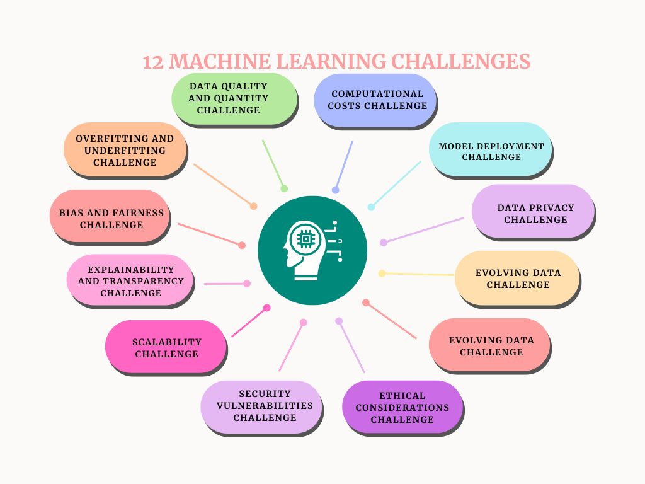
Challenges and Limitations
Data quality issues, such as missing or noisy data, can affect model performance.
Rapid changes in traffic patterns require continuous model updates and retraining.
Privacy concerns must be addressed when collecting data from mobile devices and sensors.
Notes:
Image source: https://mtplcdn.s3.amazonaws.com

Slide 10
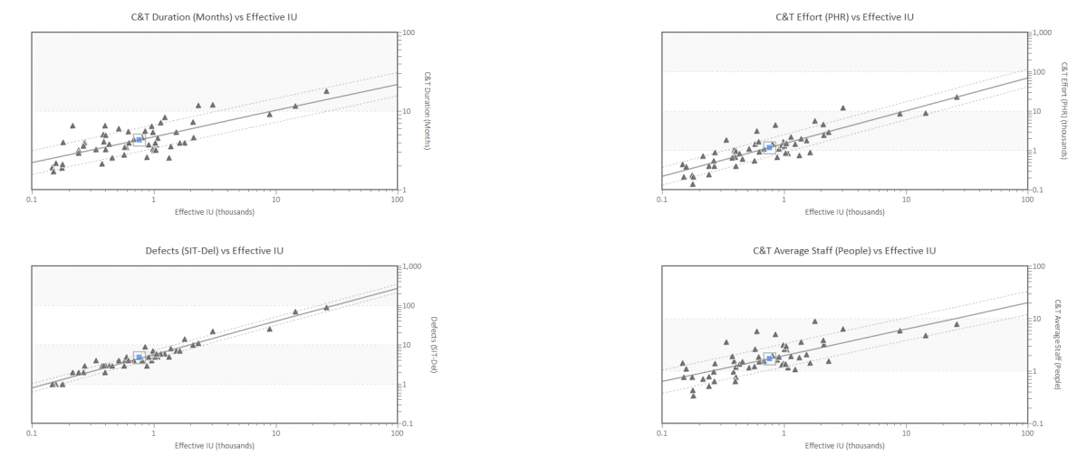
Future Directions and Innovations
Integrating IoT devices and 5G technology can enhance data collection capabilities.
Utilizing advanced AI techniques like reinforcement learning can optimize traffic flow dynamically.
Collaboration among cities, governments, and private sectors is vital to scale and improve Traffictelligence systems.
Notes:
Image source: https://www.qsm.com

Slide 11
References
(Insert relevant publications, articles, and sources related to Traffictelligence, machine learning in traffic estimation, and intelligent transportation systems.)
Your second bullet
Your third bullet

